Slide 1


SMALL BUSINESS ENTERPRISE HOW TO DO BUSINESS WITH LEON COUNTY SCHOOLS BREAKFAST
Meet & Greet

Slide 2
Welcome
Small Business

Slide 3

Agenda
Welcome
Our Mission
Policies & Procedures
Presenters
  Danny Albritton, Director, Facility and Construction
  Alan Rodgers, Operations Department Manager
  Dr. Michael R. Moore, Director, Property Management
  June Kail, Director, Purchasing Department
Superintendent of Leon County Schools
  Rocky Hanna
Board Members
  Rosanne Wood, District 2 (Chair)
  DeeDee Rasmussen, District 4 (Vice Chair)
  Georgia “Joy” Bowen, District 5
  Darryl Jones, District 3
  Alvia Striplin, District 1
Closing Remarks

Slide 4

Our Purpose
This is an opportunity for LCS Small Business Enterprise Vendors to network and meet with Leon County School Superintendent, Rocky Hanna, School Board Members and LCS District Administrators, to discuss how to do business with the District. We will talk about ways of working with each Department and potential opportunities.

Slide 5
Our Mission
Leon County Schools Small Business Enterprise Program is Designed to Support the Enhancement of Innovative Race and Gender Neutral Strategies by Promoting Qualified Small Business Participation.

Slide 6
Leon County Schools
Policies & Procedures
Small Business Development
Program 6325
Local Preference Policy 6320
Program Certification and Participation
Administration
Evaluating and Reporting
Race and Gender Neutral Policy
  Objectives of Small Business
  Development Office (SBDO)
  Scope of SBDO
  Responsibilities and Standards of the
    SBDO

Slide 7

Please Welcome Our Dynamic LCS
District Departments

Slide 8
Director, Facilities & Construction Department
Danny Albritton

Slide 9
Operation Manager, Maintenance Department
Alan Rodgers

Slide 10
Director, Property Management and Materials & Stores
Dr. Michael R. Moore

Slide 11
Director,
Purchasing
Department
June Kail

Slide 12


9/17/2019
How to do Business with Leon County Schools

Slide 13
Mission Statement
The mission of the Purchasing Department is to procure quality equipment, supplies and services in a timely, cost-effective, professional and ethical manner in an ongoing effort to support student success.

Slide 14
What Dictates how LCSB Buys Goods/Services?
LCSB Board Policy 6320, Purchasing and Contracting for Goods and Services
LCSB Board Procedure 6320A, Purchasing Procedures
LCSB Board Policy 6450, Local Purchasing Preference
Posted on the Districts’ BoardDocs website at: https://go.boarddocs.com/fla/leon/Board.nsf/Public

Slide 15
Methods for Making a Purchase
Purchase Orders: The most commonly used form of procurement issued by the district’s purchasing department.
Purchasing Card: Certain authorized district employees have been issued purchasing cards to procure materials and supplies.
Vendors are cautioned not to provide any materials and/or services without first being in receipt of a written purchase order issued to your company by the Purchasing Department.
The Board is not obligated to pay for any unauthorized materials or services.

Slide 16
Competition Thresholds
Procurement Amount | Policy | Procedure
< $8,000.00 | Use best practices | Purchases not exceeding $8,000 that are not covered by an existing competitive solicitation do not require written quotes; however, competition is encouraged
$8,000.01 - $50,000.00 | Three (3) informal quotes | Purchases over $8,000 and up to $50,000 require a minimum of three (3) informal quotes if not covered by an existing competitive solicitation.
>$50,000.00 | Formal Competitive Solicitations | The Purchasing Department will issue a formal solicitation for all purchases over $50,000 not covered by an existing competitive solicitation unless otherwise waived. The solicitation is posted on our website at www.leonschools.net/Domain/195 , advertised in the local paper and sent to prospective bidders.
The Board supports Small Business Enterprise (SBE) vendors and the purchasing department utilizes the SBDO certified vendor list for both formal and informal solicitations when applicable.

Slide 17
Formal Solicitations
Formal solicitation packages include, but are not limited to:
Invitation to Bid (ITB): typically awarded to the lowest, responsive and responsible bidder.
Request for Proposals (RFP): Used when it is not practicable for the District to specifically define the scope of work and is requesting that a responsible vendor propose a solution meeting the specifications of the solicitation. Price is a consideration in the award but not necessarily the determining factor.

Slide 18
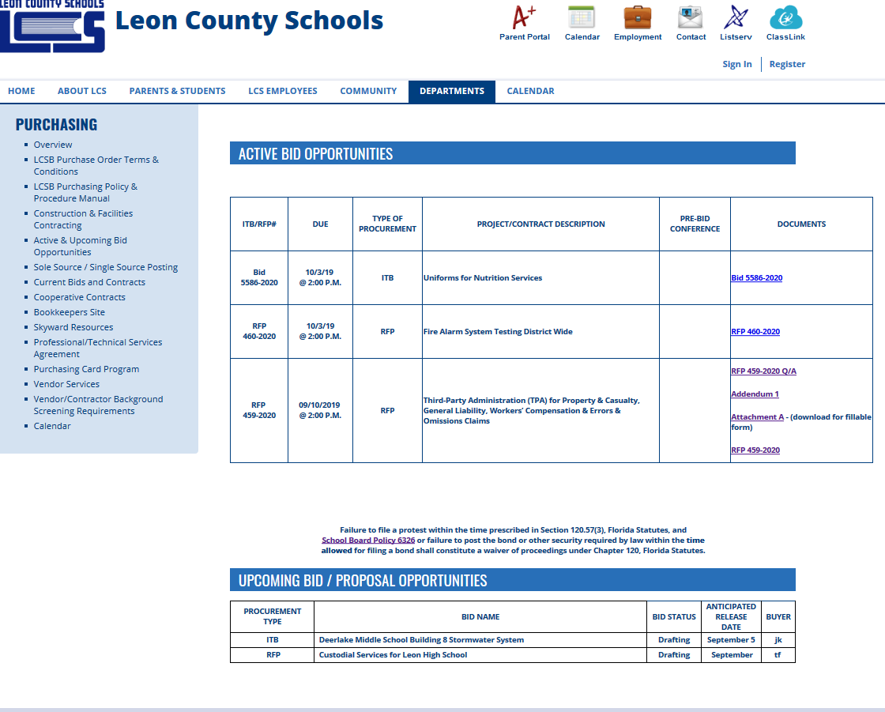
Where to Find Current Bid Opportunities www.leonschools.net/Domain/195

Slide 19
Submitting Bids
Informal Quotes between $8,001 - $50,000 are solicited informally (i.e. by phone or e-mail) and accepted either in writing or electronically.
Formal Bids may be returned by U.S. mail, private courier service, or hand delivered to the Purchasing Department. Bids must be submitted on the required forms furnished with the bid package along with all requested information for the bid to be considered responsive. Bids are time & date stamped to document when they were received. LATE BIDS WILL NOT BE ACCEPTED.

Slide 20
Professional/Technical Services Agreements (PTSA)
Governed by Board Procedure 6320.01
PTSA is a contract that is executed for on-site professional and/or technical services with companies or individuals that are not current or recent employees of the District. Schools, departments and various programs within schools and departments often use professional services in areas of special needs which require individuals/companies who are trained, certified, licensed or who have expertise and experience in areas where there is no in-house staff to perform these services.
The PTSA will be completed by the school/department representative and signed by the principal/site administrator and contractor prior to services being provided. Services should never begin without a district issued purchase order in place. The PTSA may NOT be used if the service provider is a current employee of the district, is on the School Board substitute teacher list, or creates a conflict of interest as defined in Board policy 1129.

Slide 21
How do we learn about your product or service?
Site based management
Certified SBDO list
Introduce yourself to school Administrators
Flyers that showcase your product or service
E-mail or call school bookkeepers
Network…make yourself visible…

Slide 22
Cost | School Name | Bookkeeper | Principal | School/Bookkeeper
 |  |  |  | Phone No.
Elementary Schools
0441 | Apalachee | Jemecia Franklin | Jennifer Ricardo | 488-7110
0401 | Astoria Park | Ruby Ellison | David Solz | 488-4673
1181 | Bond | Tammy Moore | Delshuana Jackson | 488-7676
0521 | Buck Lake | Rachel Moore | William Millard | 488-6133
1161 | Canopy Oaks | Cathy Healy | Paul Lambert | 488-3301
0491 | Chaires | Rita Tarin | Michele Prescott | 488-5977
1202 | Conley | Rachel McCallum | Jason Koerner | 414-5610
0511 | DeSoto Trail | Stacy Rivet | Michelle Keltner | 488-4639
0561 | Fort Braden | Lisa Hopkins | Jimbo Jackson | 488-9374
0381 | Gilchrist | Rachel Cannady | Scotty Crowe | 487-4310/488-7314
0041 | Hartsfield | Tasha Jackson | Rhonda Blackwell-Flanagan | 488-7322
1131 | Hawks Rise | Violet White | Evy Friend | 487-4733
0481 | Killearn Lakes | Autumn Mathis | Brenda Wagner | 487-9250
0421 | Moore | Gretchen Scott | Kerri Anderson | 488-2858
0171 | Oak Ridge | Brenda Carraway | Jasmine Smith | 488-3124
0311 | Pineview | Lawanda Harley | Carmen Conner | 488-2819
0231 | Riley | Raisha Goodwin | April Knight | 488-5840
1171 | Roberts | Teresa Lee | Kim McFarland | 488-0923
0091 | Ruediger | Sheena Christie | Sally Stephens | 488-1074
0071 | Sabal Palm | Jenny Robertson | Anicia Robinson | 488-0167
0431 | Sealey | Dylan Hunter | Demetria Clemons | 488-5640
0501 | Springwood | Shana Green | Sylvia Myers | 488-6225
0031 | Sullivan | Eleana Lovett | Michael Bryan | 487-1216
0131 | Woodville | Patricia Julaka | Lisa Mehr | 921-8234

Slide 23
Middle Schools
0032 | Cobb | Tara Merlau | Sarah Hembree | 488-3364
0531 | Deerlake | Kelii Kirkland | Steve Mills | 922-0990/922-6545
0451 | Fairview | Jackie Forrest | Rusty Edwards | 488-6880
0222 | Griffin | Cynthia Felix-Pierre | Zelena O'Banner | 617-5353/617-5361
1201 | Montford | Amber Kristian | Lewis Blessing | 412-8900
0291 | Nims | Dana Wiley | Kelvin Norton | 617-6161
0092 | Raa | Lisa Neeley | Christopher Small | 488-6287
1151 | Swift Creek | Michele Meyer | Sue Rishell | 414-2670
High Schools
1141 | Chiles | Danielle Riddle/Nicola Miller | Joe Burgess | 488-1756/488-6818 x252
0161 | Godby | Samantha Tejada | Desmond Cole | 617-4700
0021 | Leon | Crystal Smith | Billy Epting | 617-5720/617-5700
1091 | Lincoln | Lisa Morris | Allen Burch | 921-2516 x1409/487-2110
0051 | Rickards | Dee Anne Jackson | Doug Cook | 414-5007/488-1783
0204 | SAIL | Vickie Reeves | Tiffany Thomas-Williams | 488-2468/922-8482
Special Schools
0411 | Everhart | Bennie Donaldson | Jane Floyd Bullen | 488-5785
7004 | Virtual School | Freda Jackson | Jessica Lowe | 561-8376/561-8366
0452 | Heritage Trails Community School | Regina Johnson | Amy Alvis | 488-8927
0191 | Second Chance at Ghazvini | Renae Brown | Genae Crump | 488-2087
1502 | Juvenile Detention Center | Renae Brown | Genae Crump | 488-7672/488-2087
1211 | Success Academy at Ghazvini | Renae Brown | Jessica Lowe | 488-2087
9003 | Adult Education | Cameron Walker | Regina Browning | 717-2023/717-2020
0361 | Lively Technical Center | Matt Zadra | Shelly Bell | 487-7413
9006 | Pre-K | Allison Halpin | Brooke Brunner | 487-7296
9391 | FDLRS | Vicki Young | Eydie Tricquet | 561-6551

Slide 24
Purchasing Department Contact Information
3397 West Tharpe Street,
Tallahassee, FL 32303
Phone: 850.488.1206
Fax: 850.488.3807
www.leonschools.net/Domain/195
June Kail , Purchasing Director kailj@leonschools.net
Martharine Jones, Executive Secretary jonesm@leonschools.net
Jackie Mitchell, Coordinator PCard Program mitchellj@leonschools.net
Taneka Forbes, Purchasing Agent II forbest@leonschools.net
Nancy Scott, Purchasing Agent II scottn@leonschools.net
Michelle Castaneda, Purchasing Specialist castanedaa@leonschools.net
Robert Slappey, Secretary slappeyr@leonschools.net
We appreciate your interest in doing business with the Leon County School Board and look forward to working with you.

Slide 25
Please Welcome Our Wonderful Superintendent
Leon County School Board

Slide 26
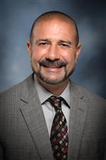
Rocky Hanna
Superintendent

Slide 27
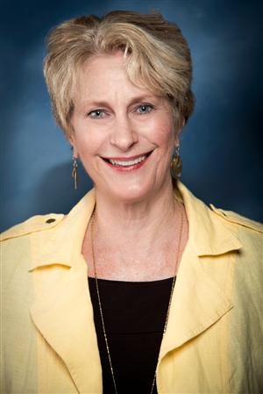
Rosanne Wood
District 2 (Chair)

Slide 28
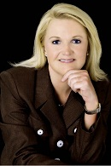
DeeDee Rasmussen
District 4 (Vice Chair)

Slide 29
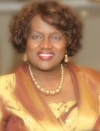
Georgia “Joy” Bowen
District 5

Slide 30
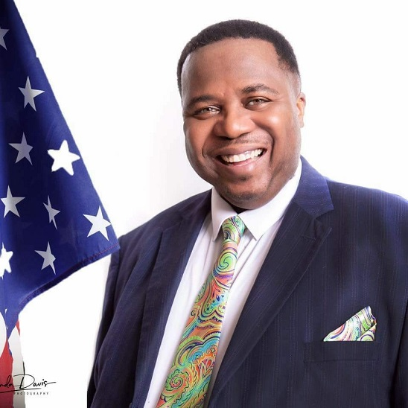
Darryl Jones
District 3

Slide 31
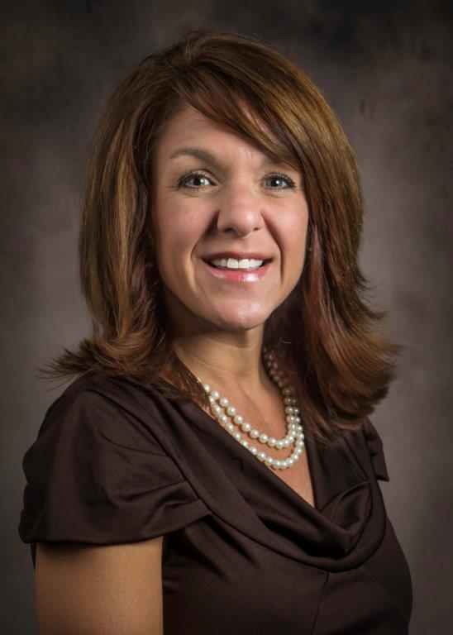
Alvia Striplin
District 1

Slide 32

Large image
Closing Remarks

Slide 33





Thank You
LaRoderick “Rod” McQueen
Small Business Enterprise
3420 W. Tharpe St., Suite 100
(850) 617- 1800

